Slide 1
Foundations Of React 18
The Power of React

Slide 2
No React knowledge needed
Except for a basic idea around what it does

Slide 3
Everything that's needed
Code along
GitHub repository JavaScript
What to Expect
Visual Studio Code

Slide 4
A JavaScript library for building user interfaces

Slide 5
Static UIs are easily manageable
Dynamic changes are hard
What Problems Does React
Solve?
Lots of code needed that is difficult to maintain

Slide 6
React helps!

Slide 7
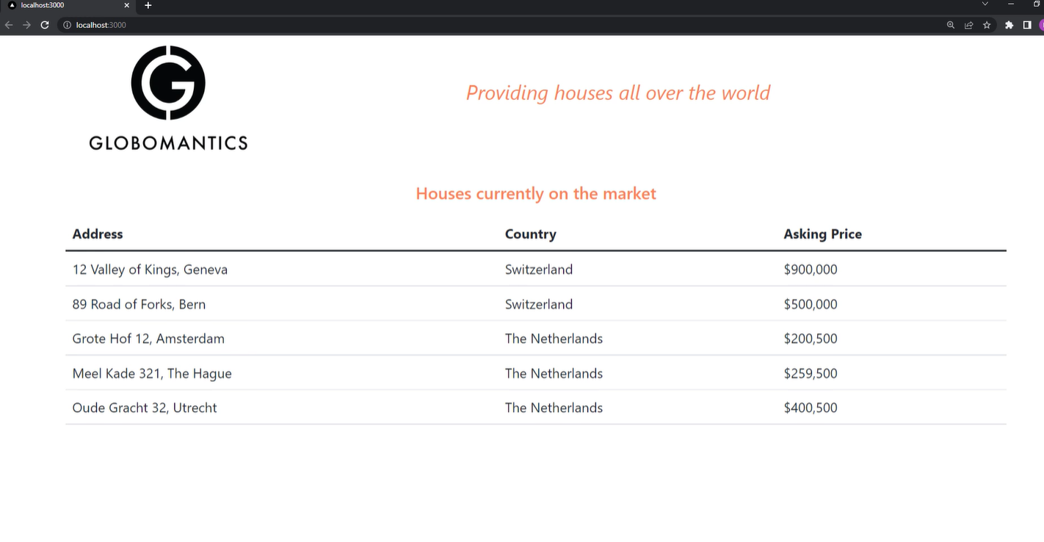

Slide 8
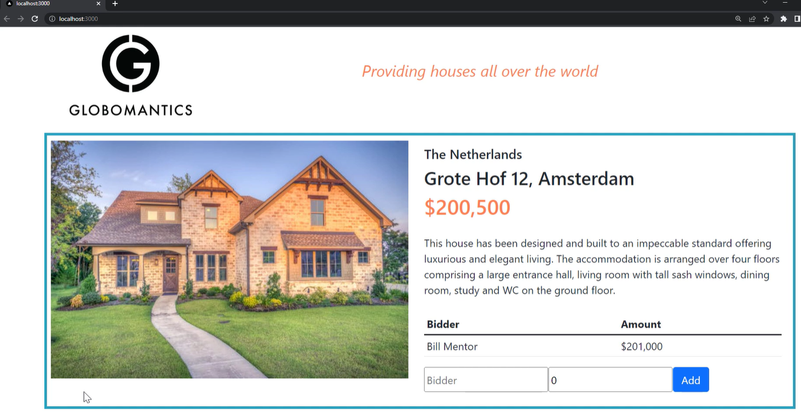

Slide 9
Creating hierarchies of reusable components
Developing a
React Application
Outcome: know to create and compose components
Outcome: understand the features around components

Slide 10
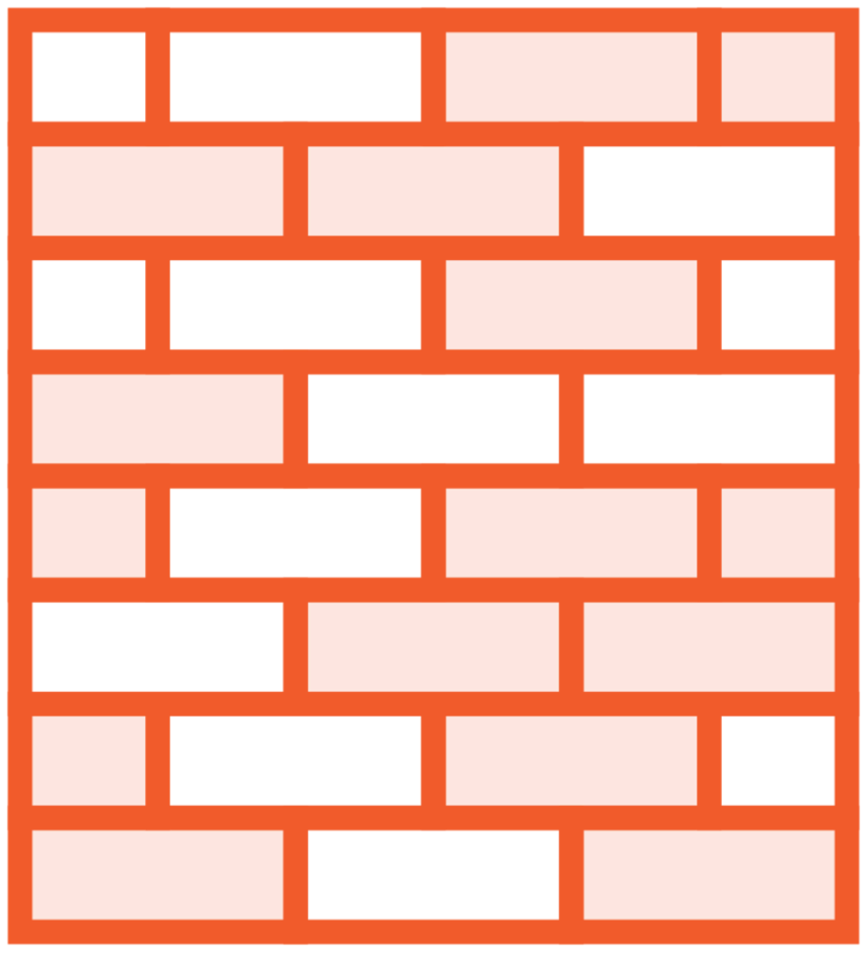


Core React Features
Structure with components Reusability
Have state
UIs declared in JavaScript Rendered output changes when state is updated
Efficiency with reconciliation Only updates the parts
of the UI that changed

Slide 11
Next up:
Anatomy of a React Application

